Slide 1
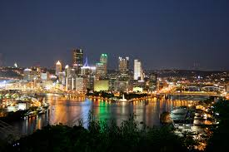
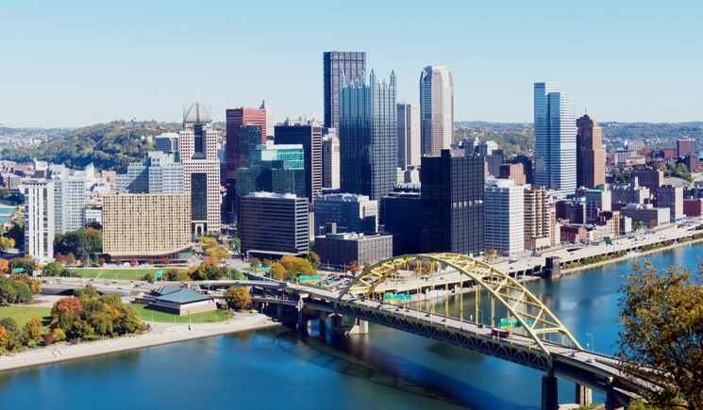
Pittsburgh Crime Project
PCP Group: Ema, Luiz, Peter, Stevie, and Liam

Slide 2
Pittsburgh, PA… Fun Facts?
Pennsylvania is the sixth largest populated state in the US
Pittsburgh is the second largest city in Pennsylvania
estimated population 310,000.
51.9% females
48.9% males
Mean age 33
Source:- http://pittsburghpa.gov/pittsburgh/pgh-about

Slide 3
Pittsburgh Crime Data
Arrest Data
Source: data.gov
Rows correspond to individual arrests
Time Period: December 12, 2005 to March 28,2019
API: Dark Sky
Historic Weather Data
Crime Code Conversion Data
Source: https://www.pacode.com/secure/data/204/chapter303/s303.15.html
Copy and Pasted into a CSV

Slide 4
Initial Goals
Wanted investigate what has a relationship with crime
Weather
Time
Gender and Race
Location

Slide 5
Initial Thoughts / Motivations
Thought there would be a relationship between weather and crime
More crime when there is bad weather?
More severe crime with bad weather?
Is Crime related to Age and/ or Gender?
Number of Crime incidents
Severity of Crimes?

Slide 6
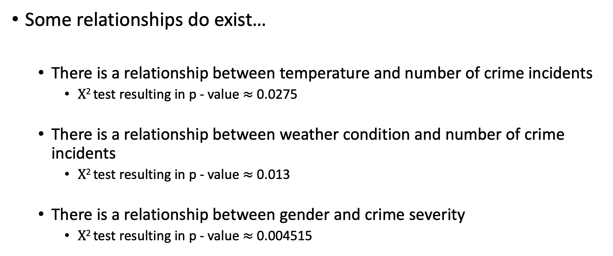
Findings
Some relationships do exist…
There is a relationship between temperature and number of crime incidents
$Χ$² test resulting in p - value $≈$ 0.0275
There is a relationship between weather condition and number of crime incidents
$Χ$² test resulting in p - value $≈$ 0.013
There is a relationship between gender and crime severity
$Χ$² test resulting in p - value $≈$ 0.004515

Slide 7
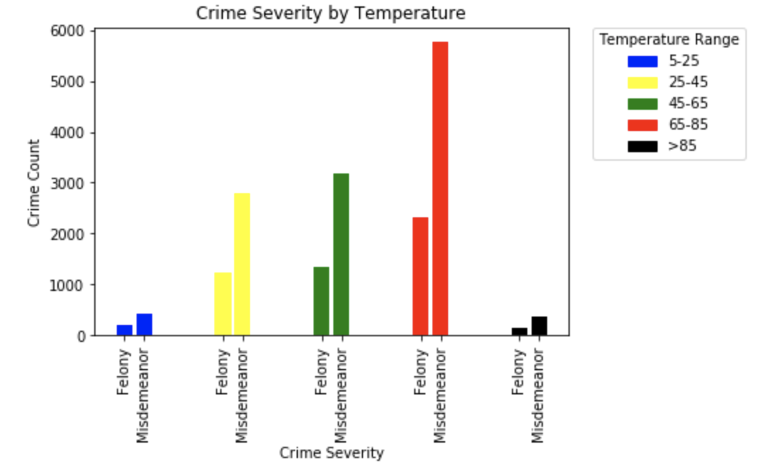
Crime Severity by Temperature
Broke Temperature into 5 groups
← See temperature range
Small Number of crimes at extreme hot and cold weather
Contradict initial thought
Very disappointing
Fewer days of extreme temperature?

Slide 8
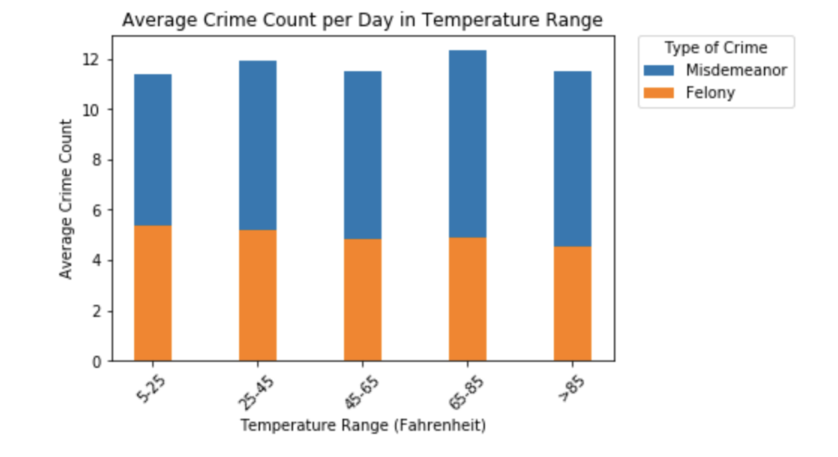
(Relative) Crime Severity by Temperature
Normalize for number of days in that time period with that crime type
Count of crimes * Number of days in temperature range / total number of days in time period
Paints a completely different picture than straight counts

Slide 9
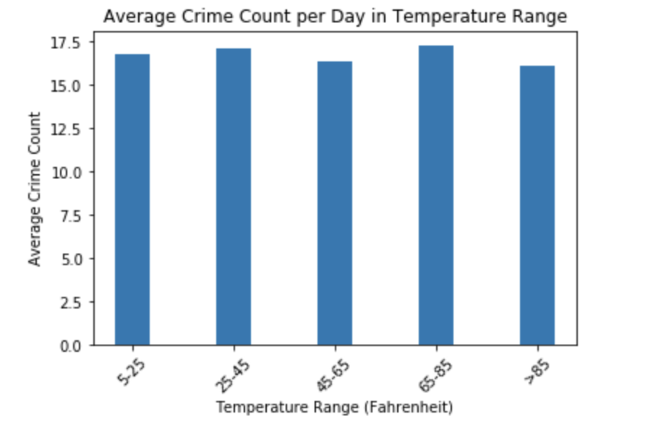
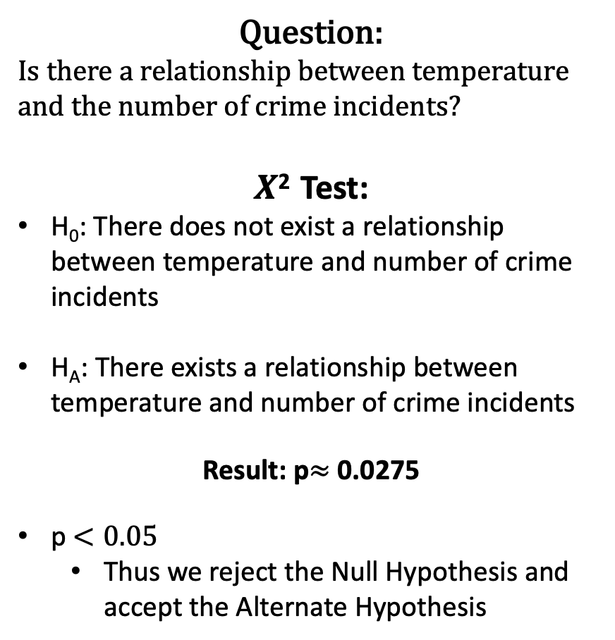
(Relative) Crime Counts by Temperature
Question:
Is there a relationship between temperature and the number of crime incidents?
$Χ$² Test:
H₀: There does not exist a relationship between temperature and number of crime incidents
H_{A}: There exists a relationship between temperature and number of crime incidents
Result: p$≈$ 0.0275
p $<0.05$
Thus we reject the Null Hypothesis and accept the Alternate Hypothesis

Slide 10
Crime By Weather Condition Analysis
Weather Conditions:
Sunny
Cloudy
Snow
Rainy
Humid
Foggy

Slide 11
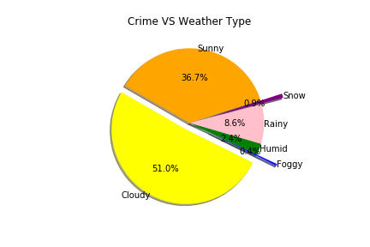
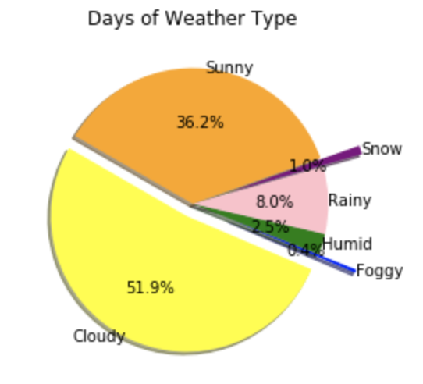
- Grouping 15 weather categories from API response into 6 to analyze data
Percentage of total crime broken down by weather condition
Percentage of days broken down by weather condition

Slide 12
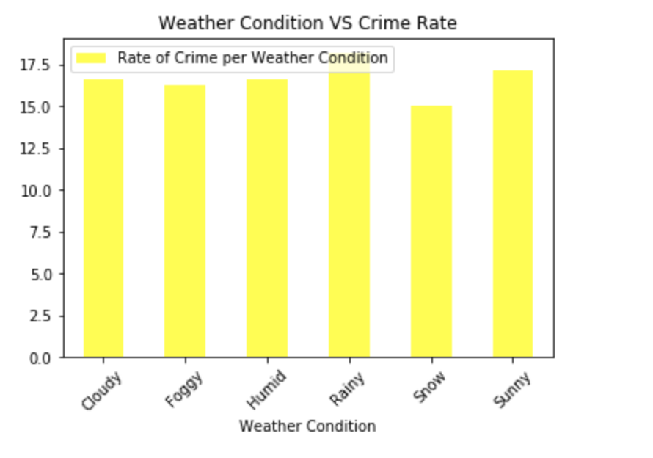
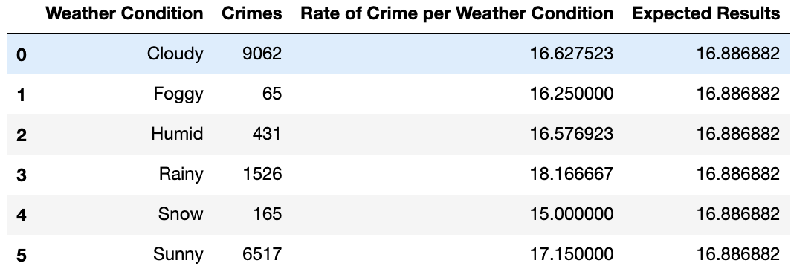
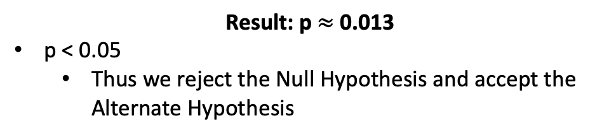
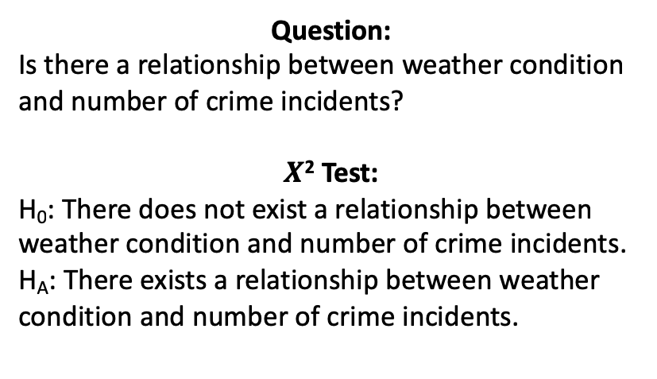
Question:
Is there a relationship between weather condition and number of crime incidents?
$Χ$² Test:
H₀: There does not exist a relationship between weather condition and number of crime incidents.
H_{A}: There exists a relationship between weather condition and number of crime incidents.
Result: p$≈$ 0.013
p < 0.05
Thus we reject the Null Hypothesis and accept the Alternate Hypothesis

Slide 13
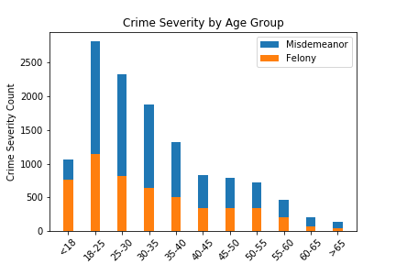
Frequency Distribution of Pittsburgh Severity by Age Group

Slide 14
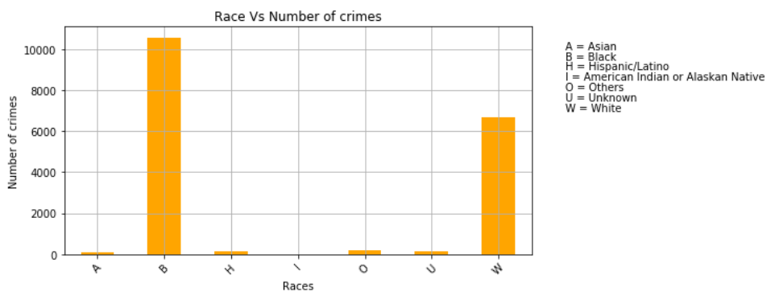
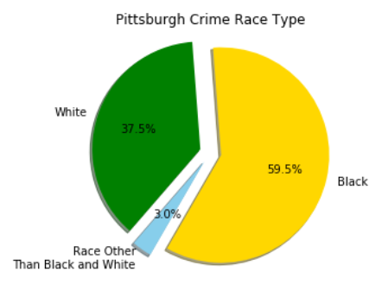
Frequency distribution of Pittsburgh Crime by Race

Slide 15
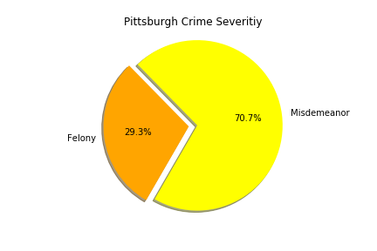
% proportion Pittsburgh Crime by Severity

Slide 16
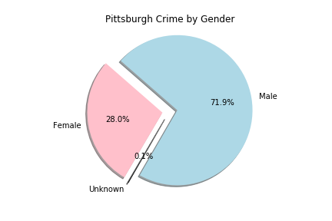
% proportion of Pittsburgh Crime by Gender

Slide 17
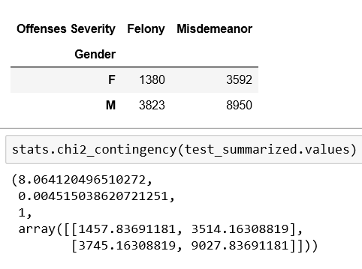
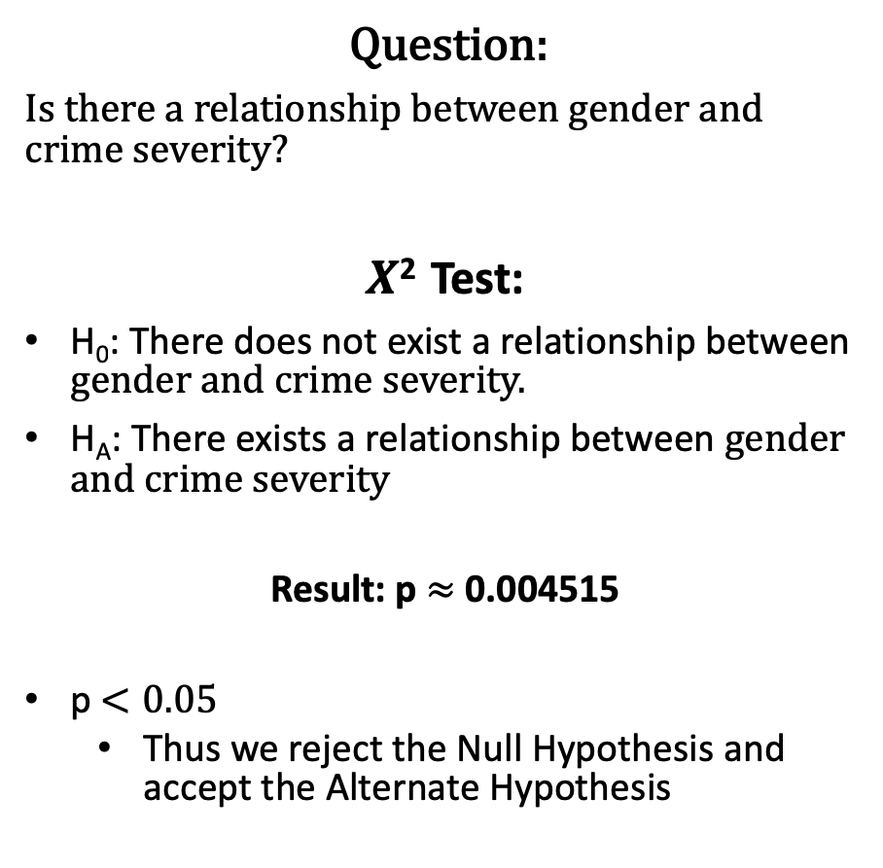
Gender and Crime Severity Test
Question:
Is there a relationship between gender and crime severity?
$Χ$² Test:
H₀: There does not exist a relationship between gender and crime severity.
H_{A}: There exists a relationship between gender and crime severity
Result: p $≈$ 0.004515
p $<0.05$
Thus we reject the Null Hypothesis and accept the Alternate Hypothesis

Slide 18
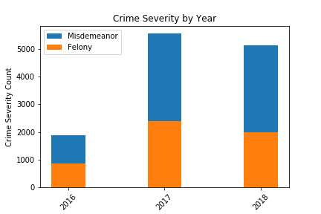
Frequency distribution of Pittsburgh Crime Severity by Year

Slide 19
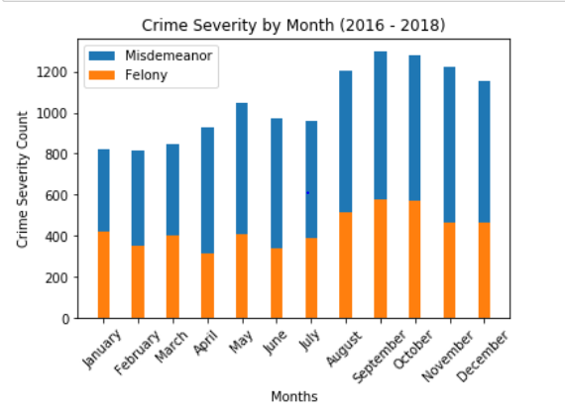
Frequency distribution of Pittsburgh Crime Severity by month

Slide 20
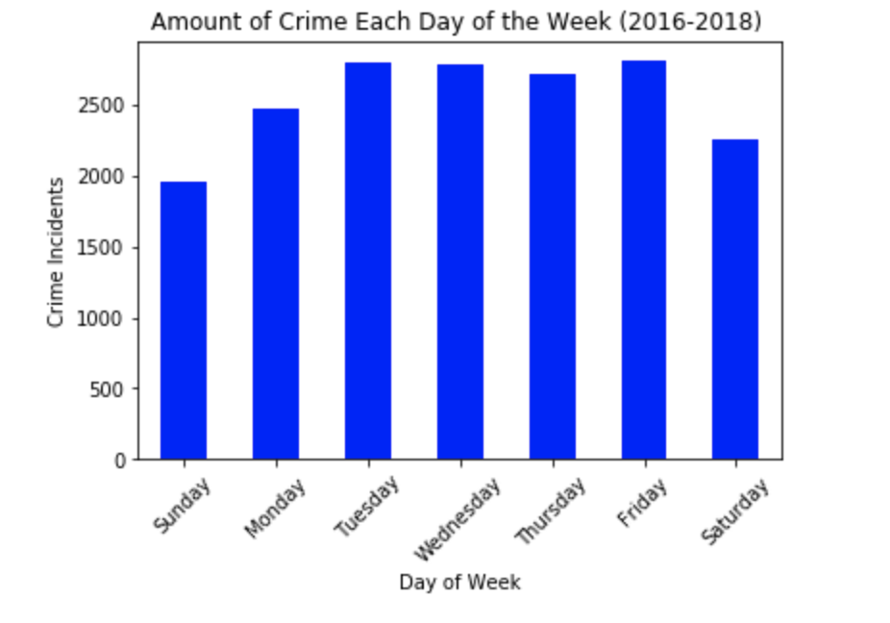
Amount of Crime Each Day of the Week
- More crime happens in Pittsburgh
during Tuesday-Friday.
- Saturday and Sunday have the fewest
crime incidents.

Slide 21
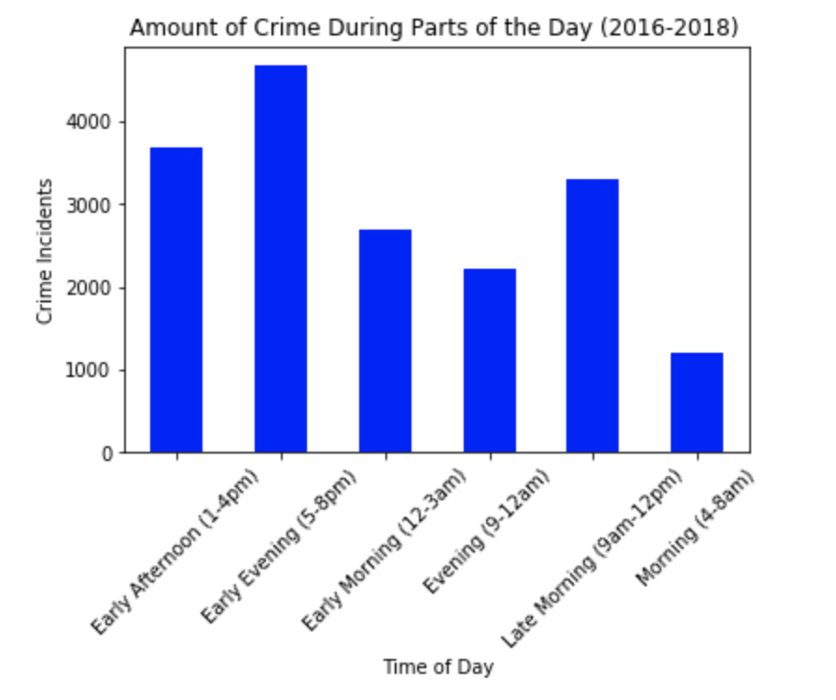
Amount of Crime During Parts of the Day
- Most crimes in Pittsburgh happen
during daytime/evening hours.
- There is a significant spike in crime
in the late evening hours.

Slide 22
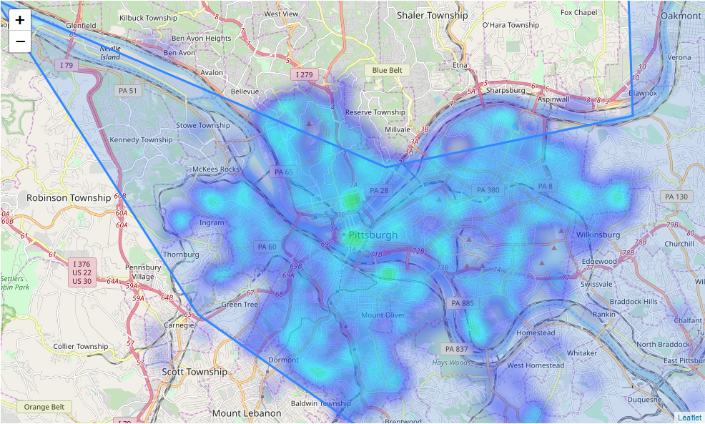
Crime by Location

Slide 23
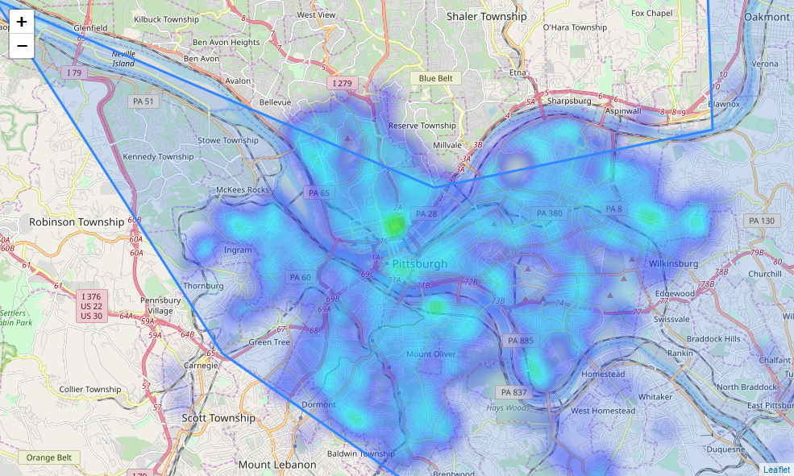
Misdemeanors by Location

Slide 24
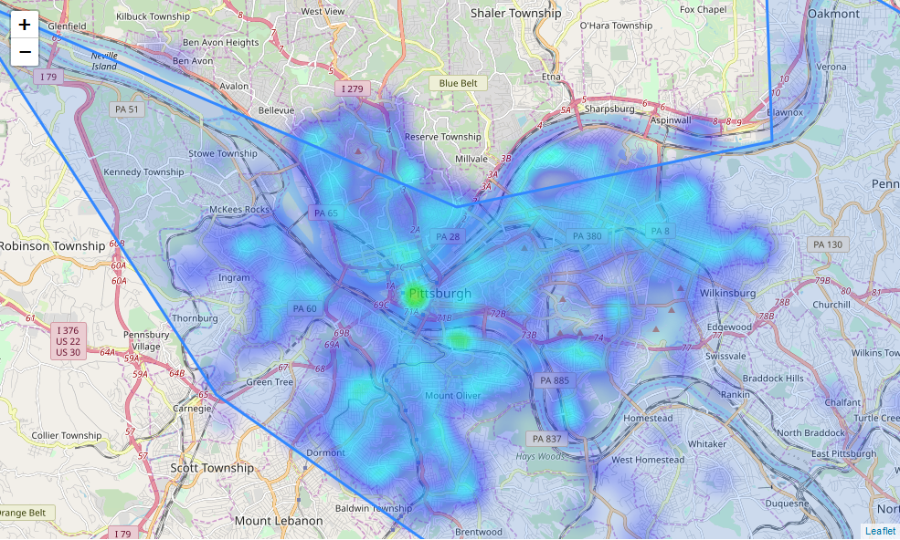
Felonies by Location

Slide 25
Data Cleaning… so much fun
Original Data set had around 30,000 arrests (29,418 to be exact)
After cleaning had around 18,000 arrests (17,766 to be exact)
Why the dropped data?
Missing Data
Only a handful of arrests before February 2016
Crime Code Conversion

Slide 26
Data Cleaning… Crime Code Conversion
Wanted to convert alpha-numeric crime codes to Misdemeanor / Felony
Approximately 2,000 distinct Crime Code
Outside source for conversion
Account for differences in code conversion data and arrest data
Inconsistent Code usage in Arrest Data

Slide 27
Difficulties
Dark Sky API
1,000 pulls per day per key
Had to use sparingly
Ended up creating and using multiple keys
Cleaning
Parsing codes
Conditionals and splits to account for inconsistencies
Github
No need to elaborate

Slide 28

Darksky API
We used the Darksky weather API (https://darksky.net/dev ) in order to pull temperatures for Pittsburgh, PA from 2/12/16 to 12/31/18. Temperatures were pulled at 12:00 PM for each day.
Within each pull, we extracted the temperature as well as the type of weather (rain, snow, clear, etc.), created a data frame, then exported this to a CSV file.
New columns added from API
-Temperature
-Weather Condition (we cleaned these original 15 categories into 6)

Slide 29
If Only We Had More Time
Dig deeper into the type of relationships
Temperature and Crime
Weather Condition and Crime
Gender and Crime intersecting with:
Temperature
Weather Condition

Slide 30
Looking Back
More focus on initial question
We went too broad
Would have liked to get more depth than breadth
Thought more about data sources
API and crime code conversion took a long time

Slide 31
QUESTIONS??

